Slide 1
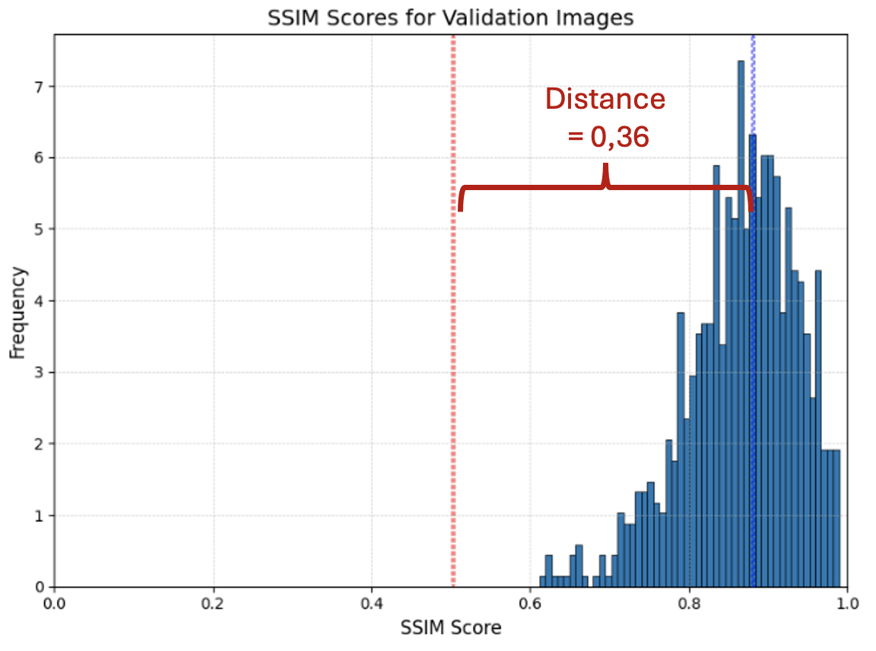
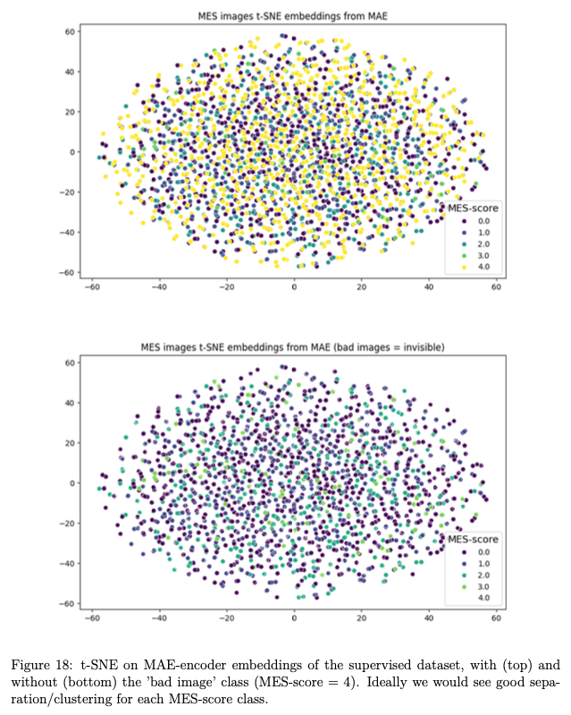
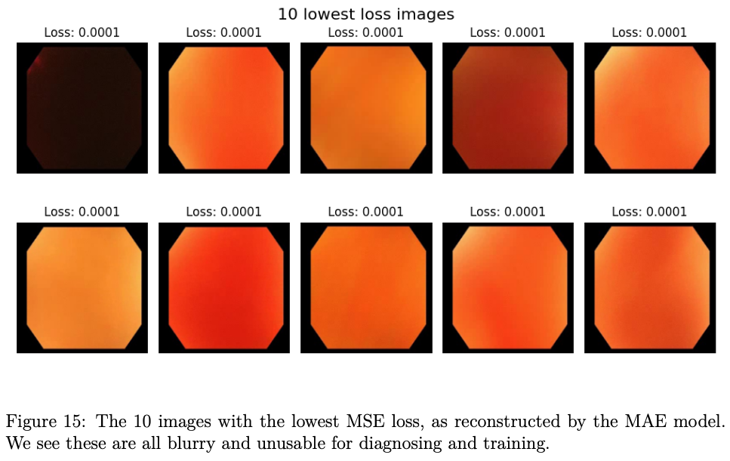
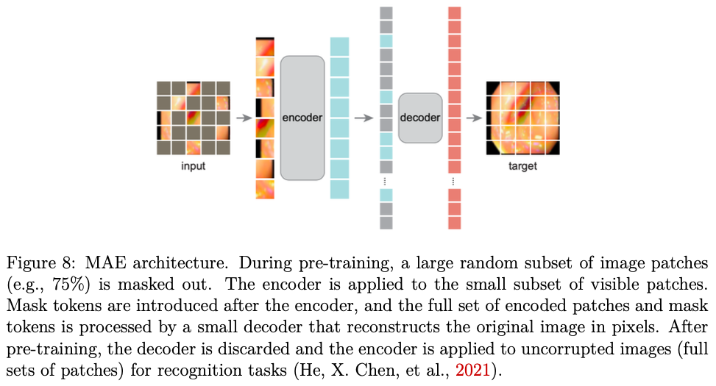
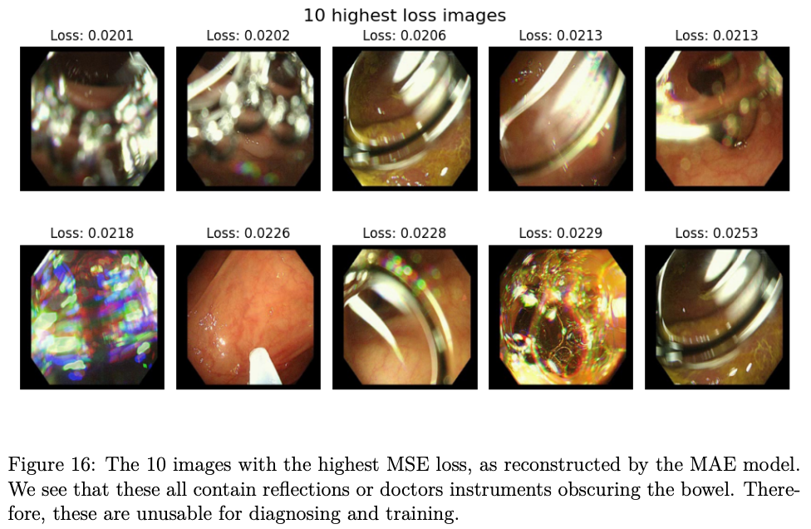
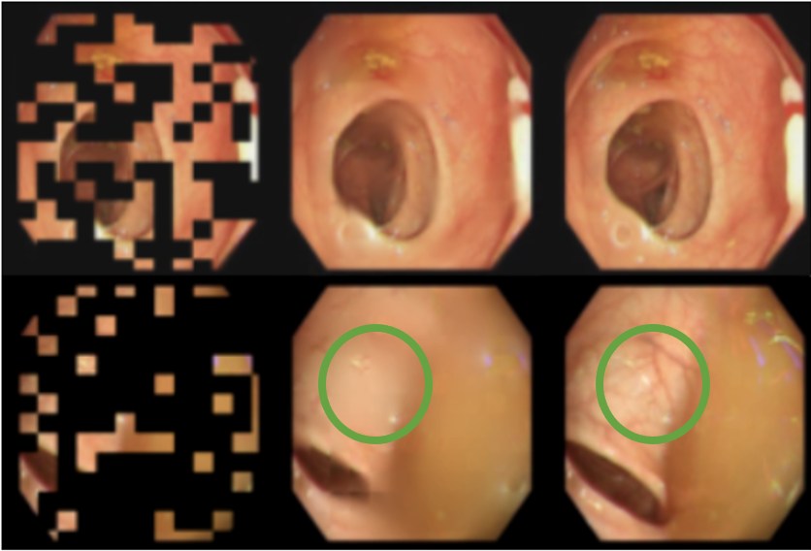
Foundational Model for Endoscopy
Alexander Mittet

Slide 2
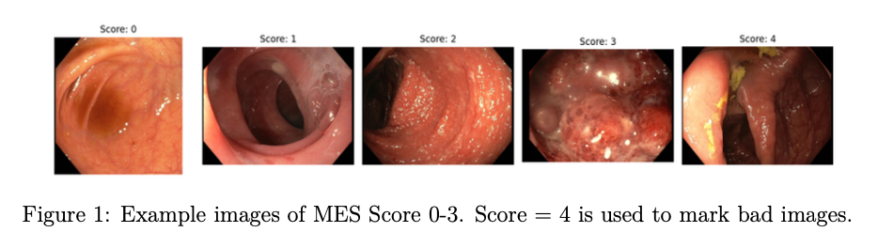
Ulcerative Colitis

Slide 3
Ulcerative Colitis
Problem:
Doctors’ assessment differ a lot
Cohen’s kappa score of agreement = 0.65

Slide 4


Solution

Slide 5
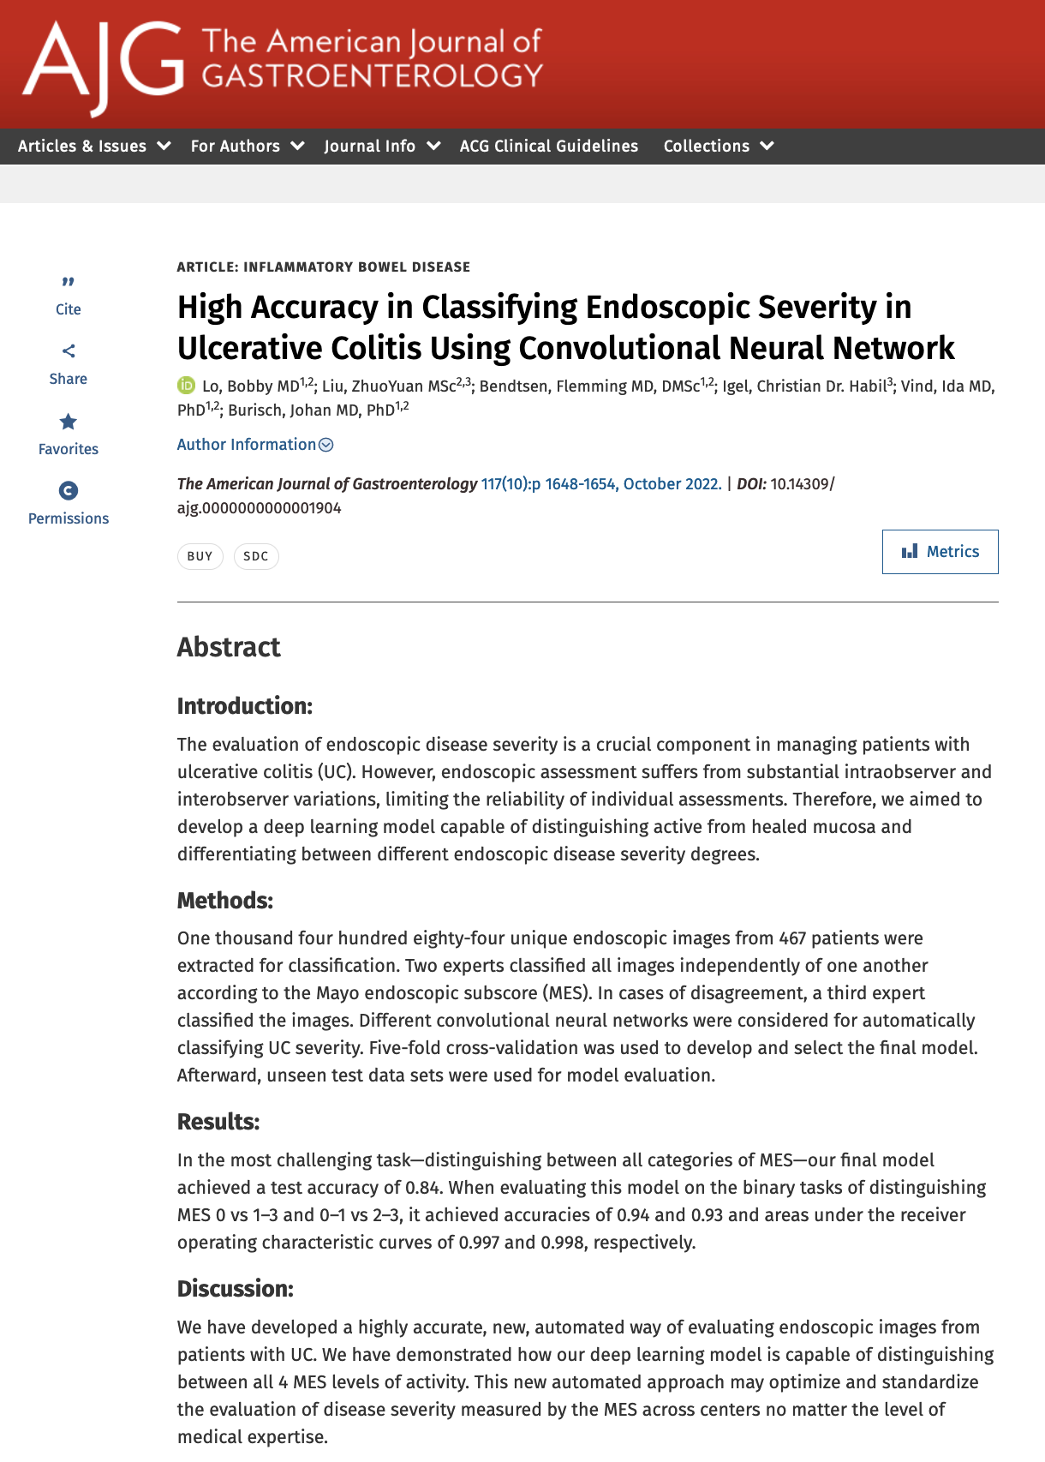
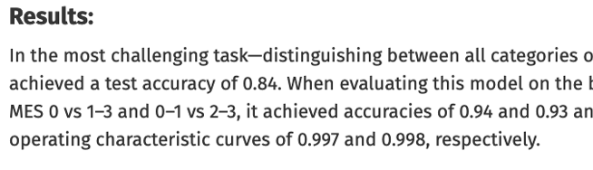

Slide 6
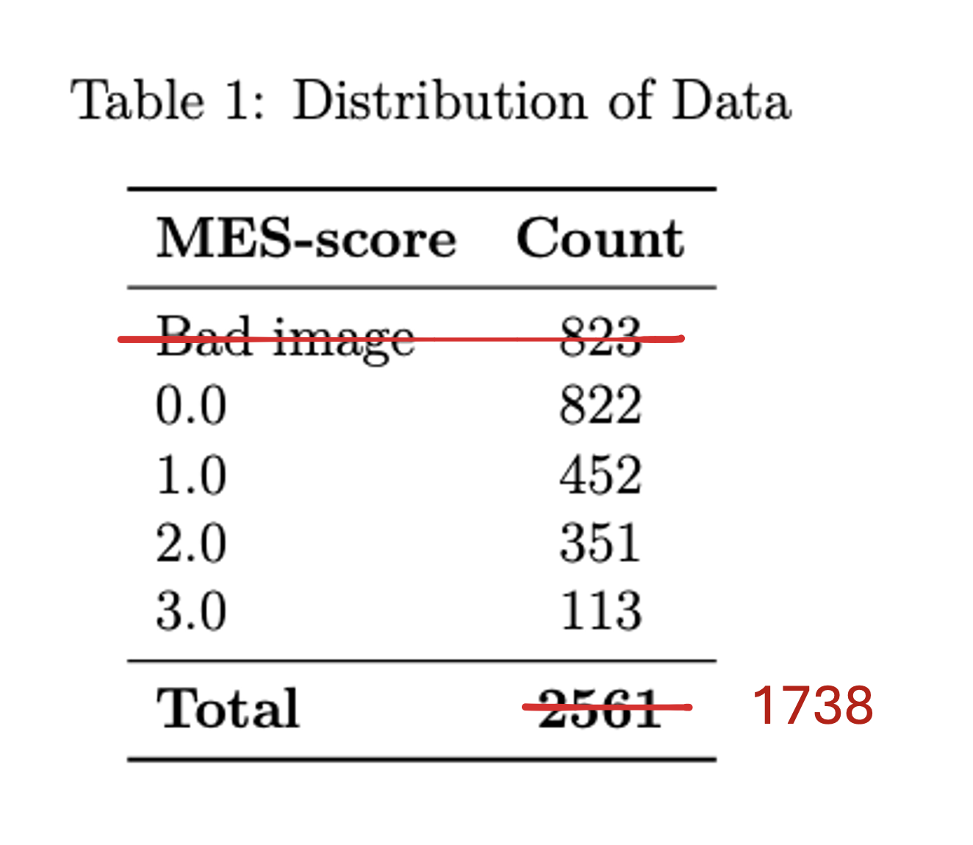

Slide 7

More data
= Better accuracy
= Higher cost

Slide 8
Labelled data = expensive
Unlabelled data = basically free

Slide 9
New problem: Doctors don’t press record...

Slide 10
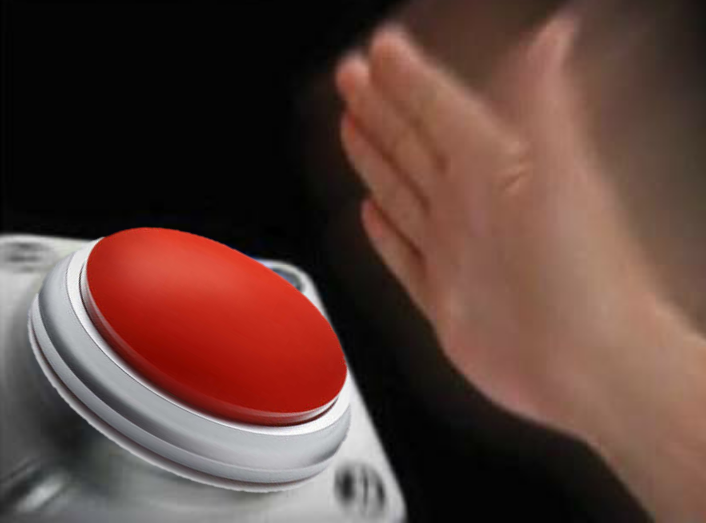
“Dear Doctors, please press record during your endoscopy consultations”
Alexander Mittet

Slide 11
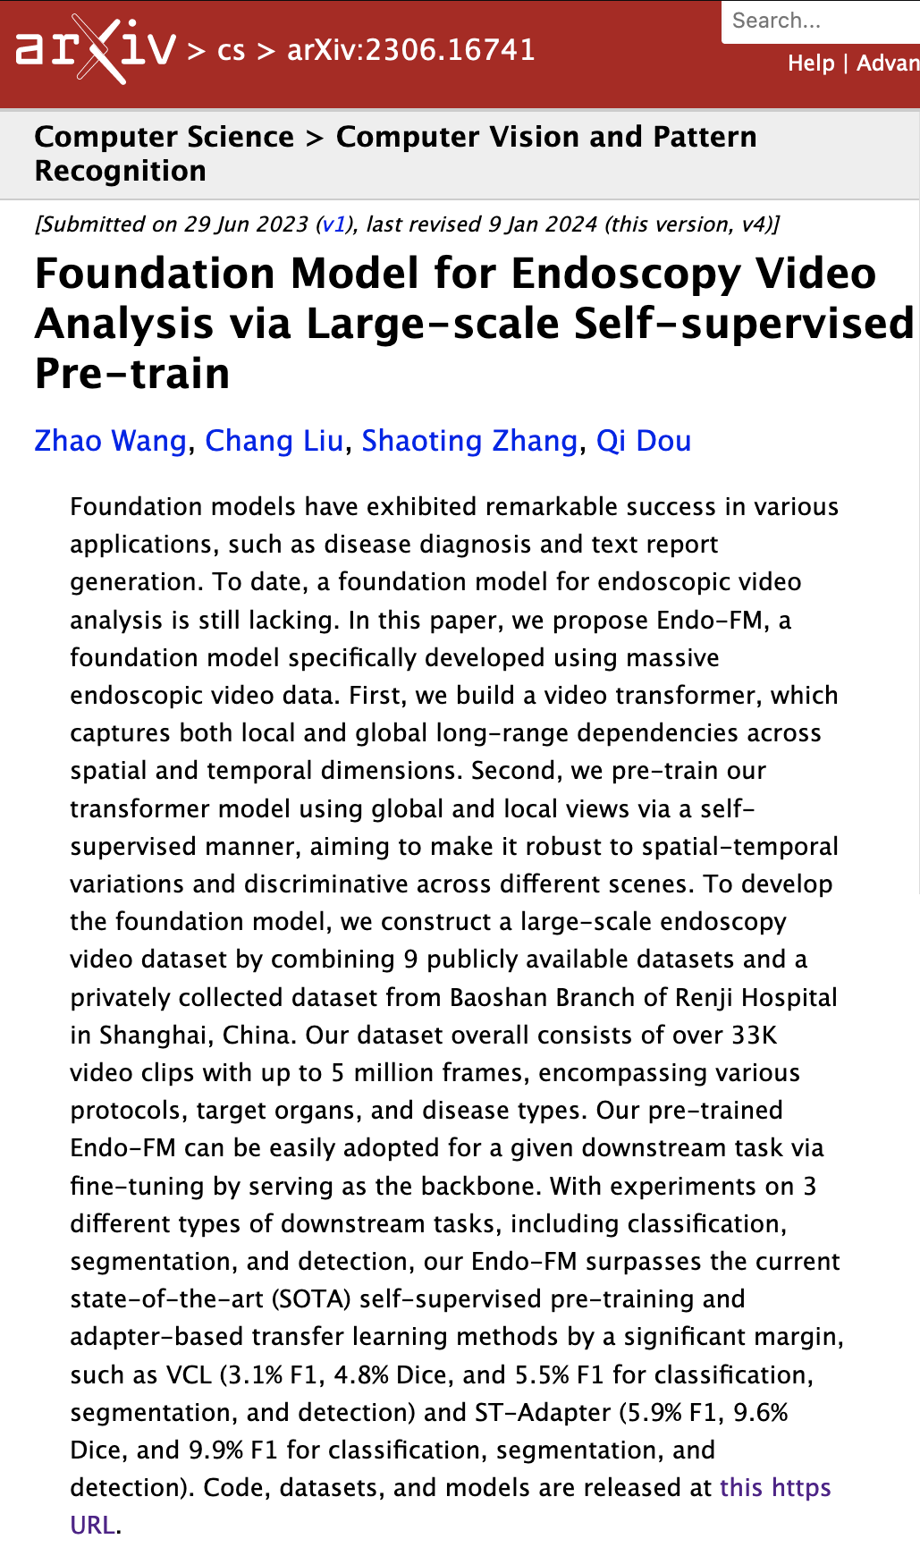
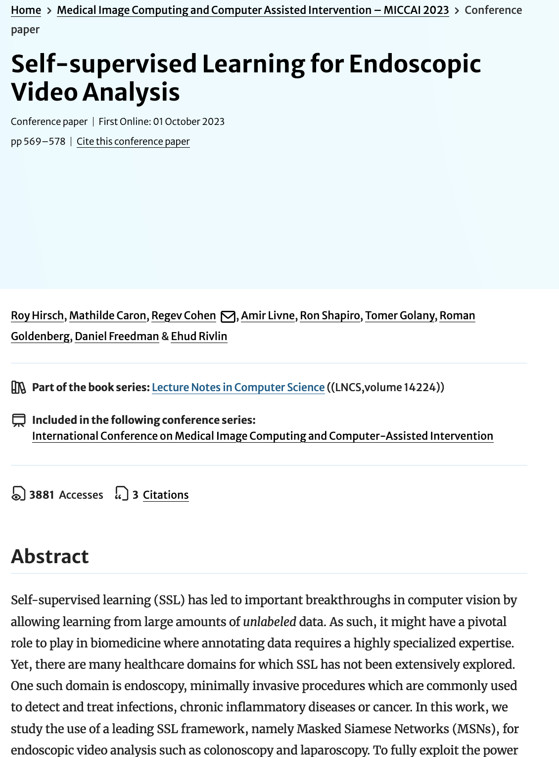
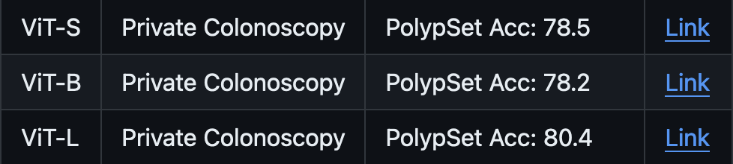


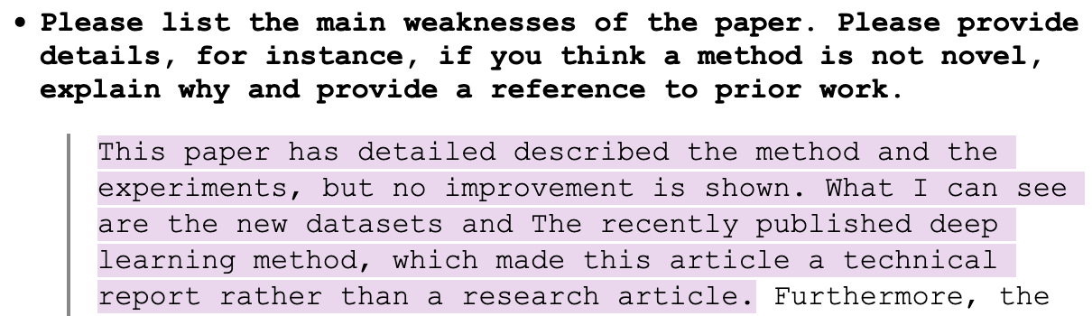

Slide 12
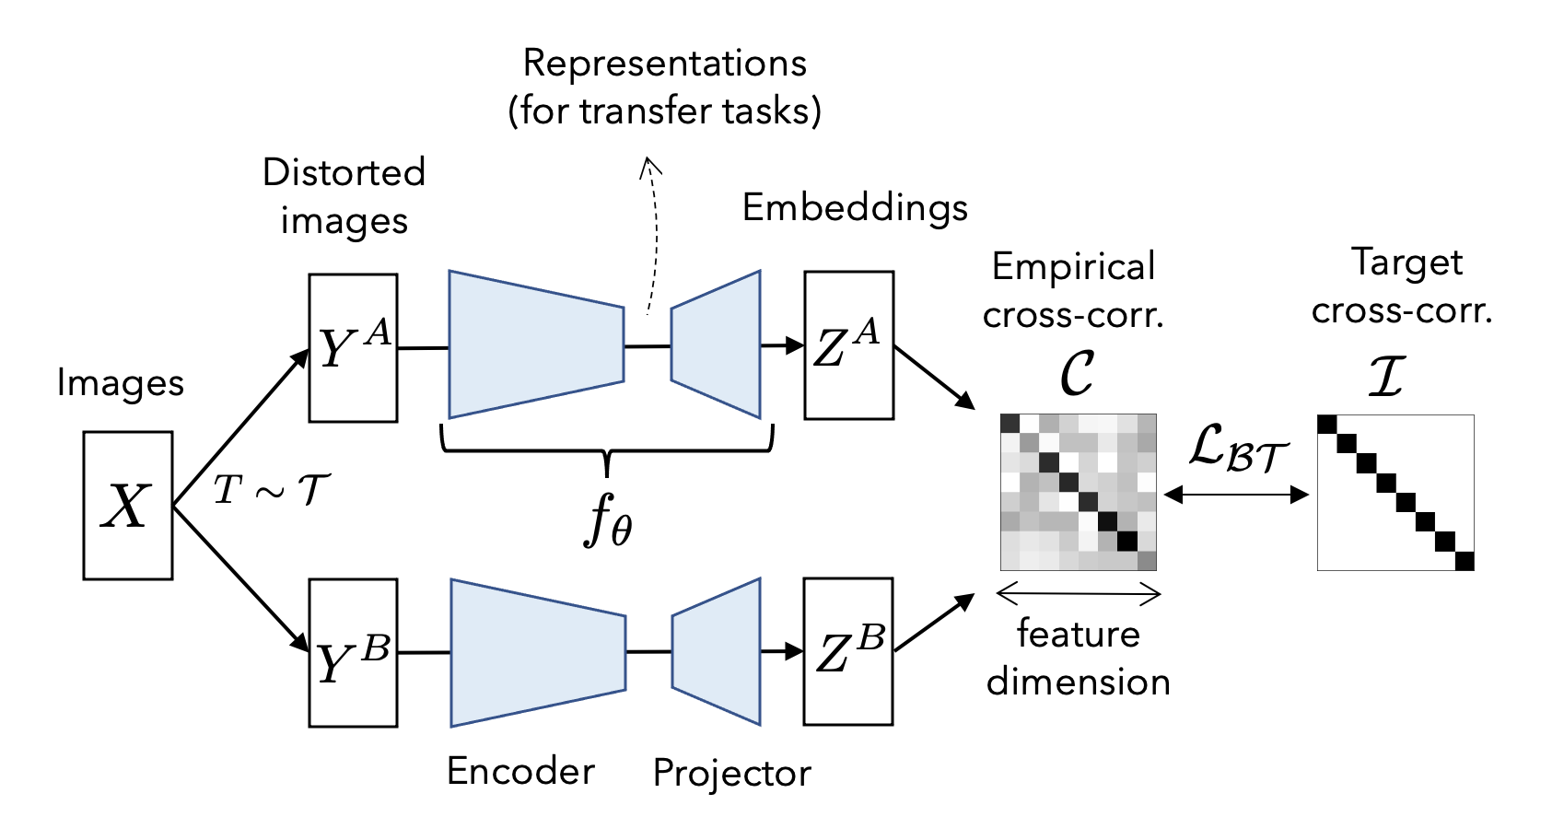
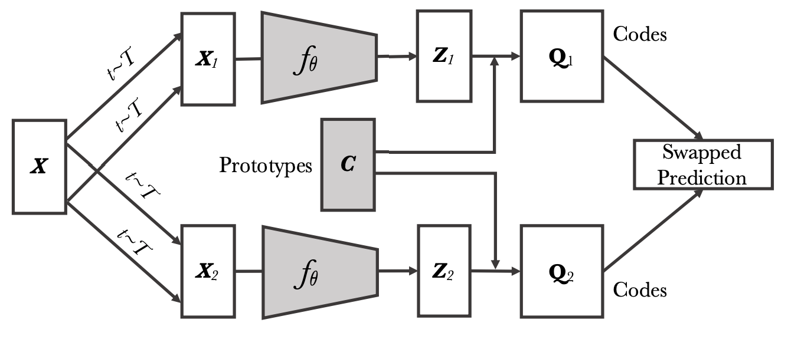
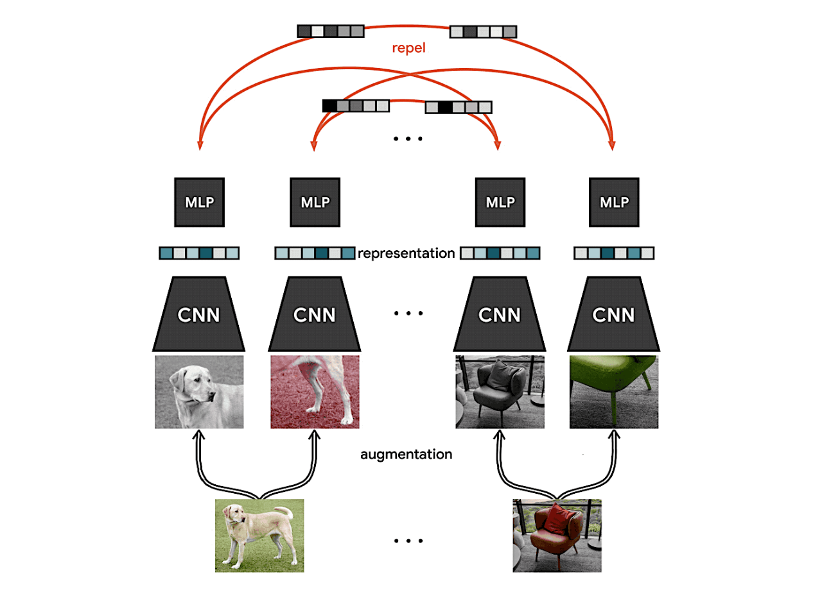
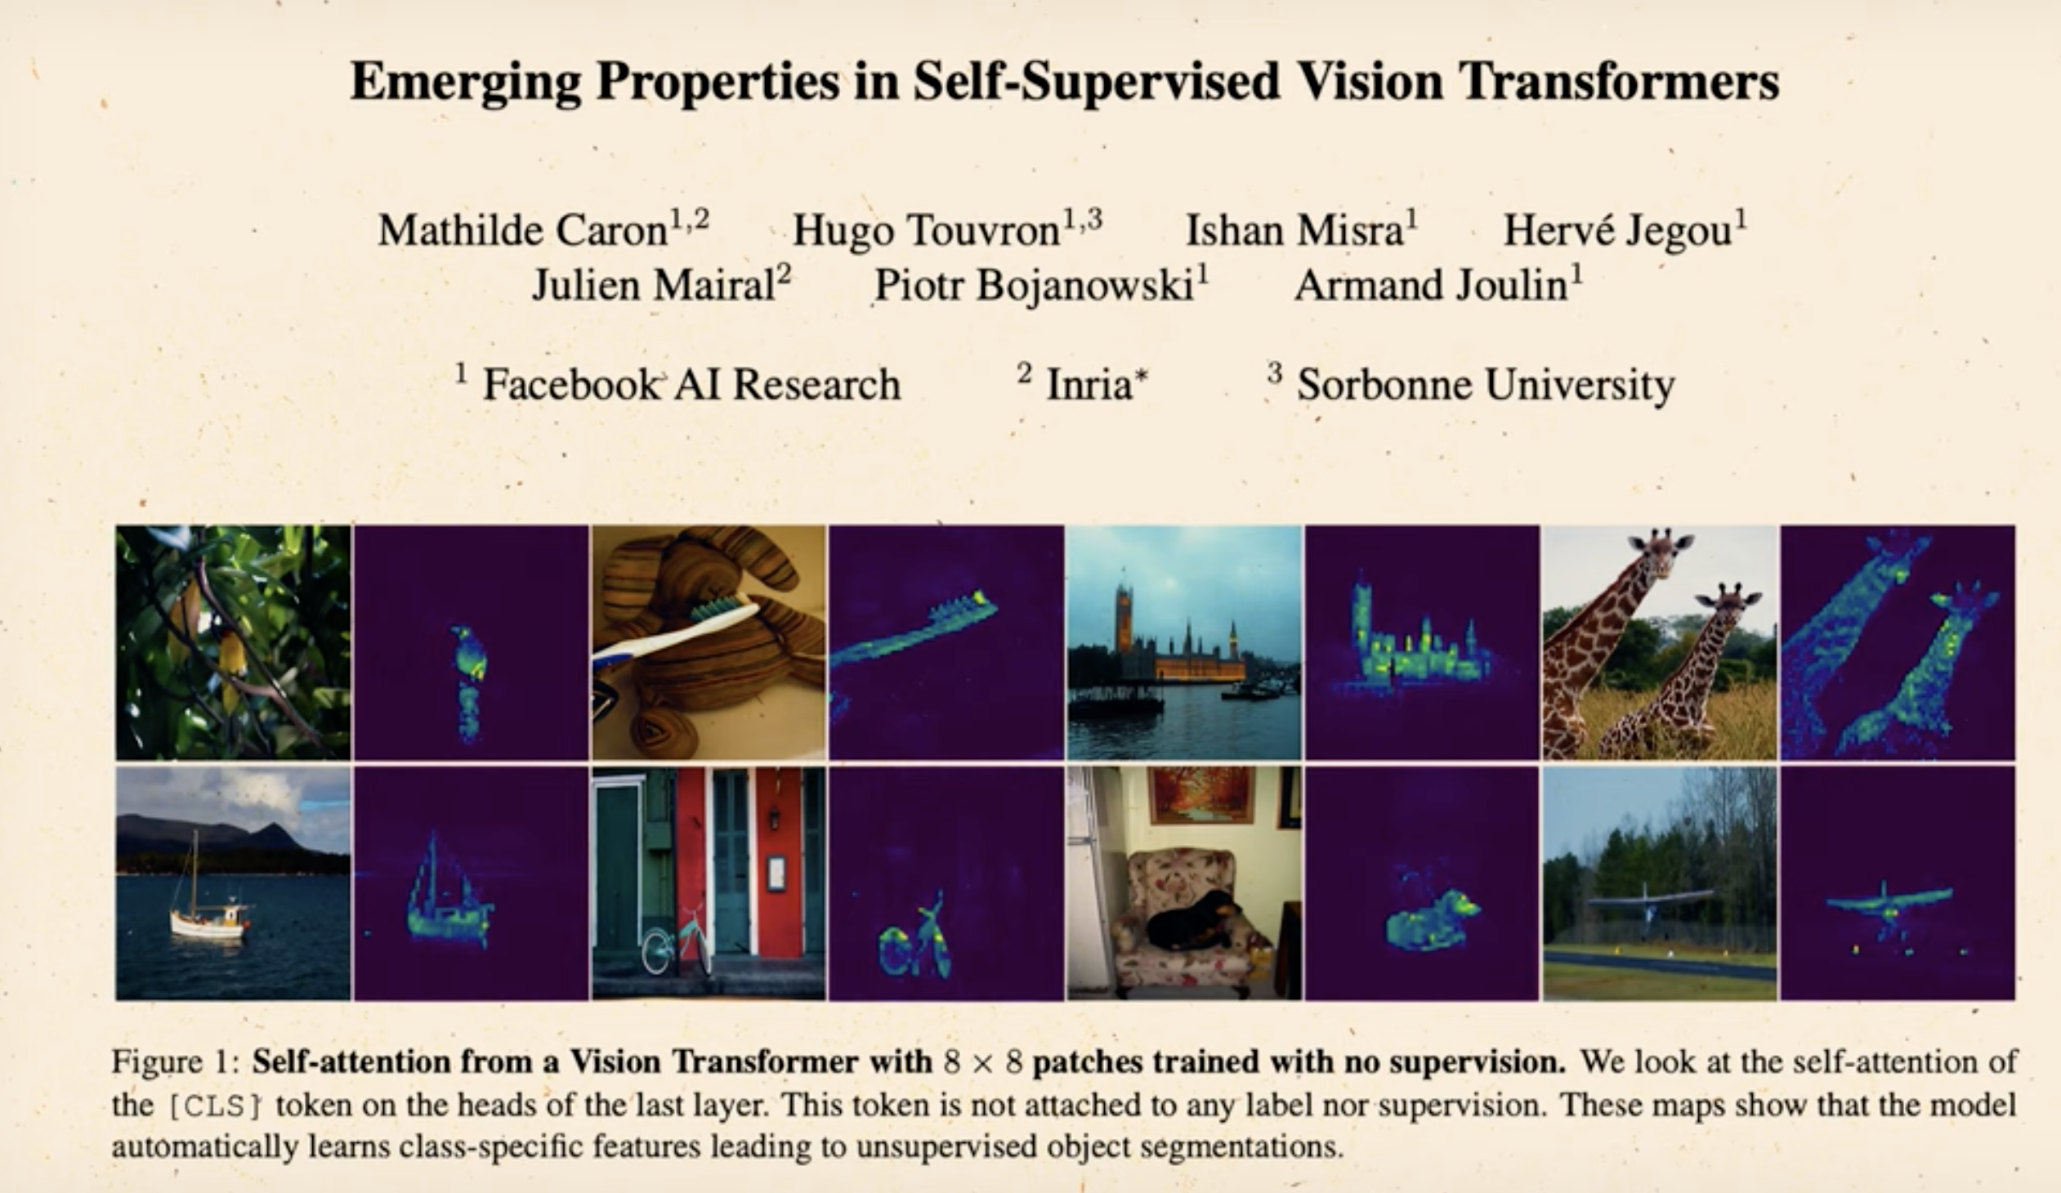
Barlow Twins
SWAV
DINO
SimCLR

Slide 13
Barlow Twins
SWAV
Only latent representation
DINO
SimCLR

Slide 14
Barlow Twins
SWAV
Only latent representation
DINO
SimCLR
Only visual in the end

Slide 15
Barlow Twins
SWAV
Hard to understand!
DINO
SimCLR

Slide 16


Output space
Easy to understand
MAE
Image patch
Blank patch
We can see what's happening
Can be trained with less compute
Notes:
We make patches
*It gives latent represtntaion
BLUE = patches
GREY= blank
Decoder takes BLUE og blank og reconstructs
Should give semantisk /latent representation

Slide 17
Transformer
MAE
Image patch
Blank patch
Why not use CNNs?
Hard to use patches
Blanks reduce compute in ViTs
Notes:
We make patches
*It gives latent represtntaion
BLUE = patches
GREY= blank
Decoder takes BLUE og blank og reconstructs
Should give semantisk /latent representation

Slide 18
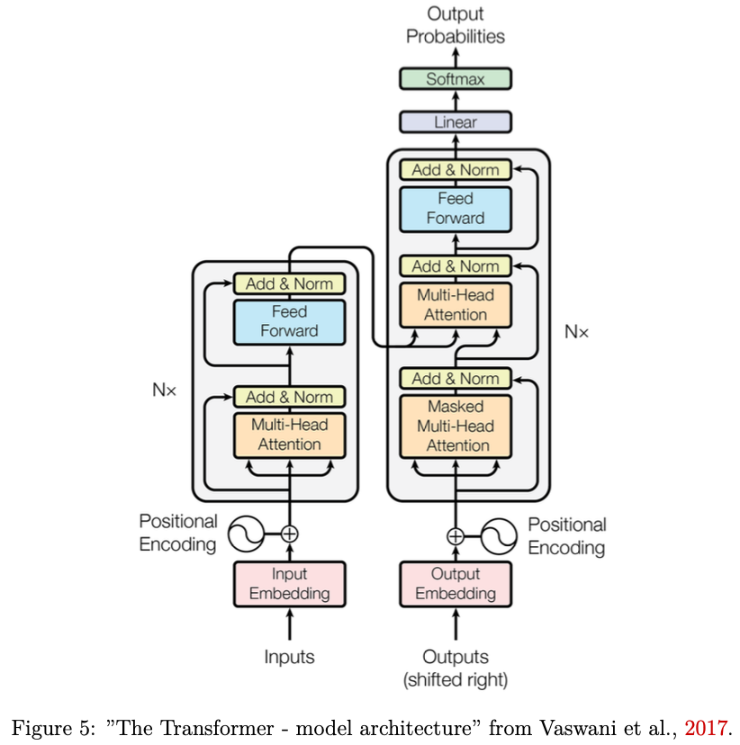
Core of MAE:
The Transformer

Slide 19
Core of MAE:
The Transformer
Decoder
Encoder

Slide 20

Latent representation
MAE
Image patch
Blank patch
We can see what's happening
Can be trained with less compute
Notes:
hvorfor er det fedt?
fordid vi kan se hvad der sker – hele tiden
det kan vi ikke med de andre
+ den kan trænes med mindre

Slide 21
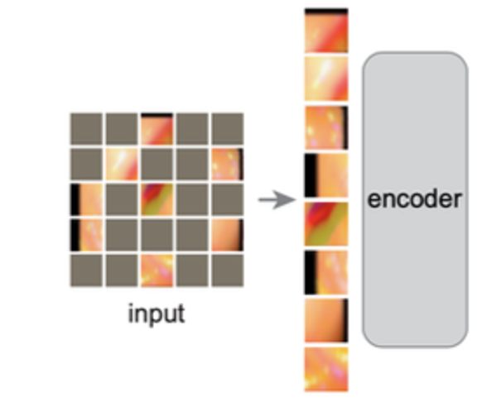
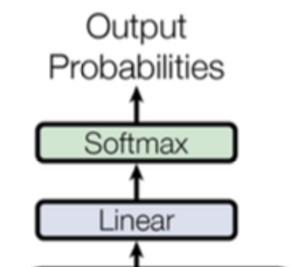
Latent representation
MAE
Latent representation
Classifier
Notes:
hvorfor er det fedt?
fordid vi kan se hvad der sker – hele tiden
det kan vi ikke med de andre
+ den kan trænes med mindre

Slide 22
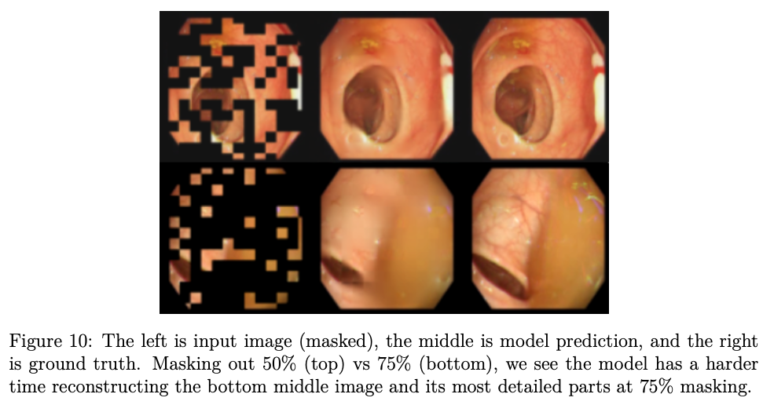
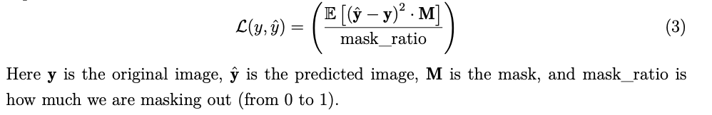
Method: MAE
50% masking
370.000 unlabelled images
Trained for 33 epochs ( = 24h GPU time)
7.5 M params in total
5.5 M params in encoder
MSE loss for MAE
75% masking

Slide 23
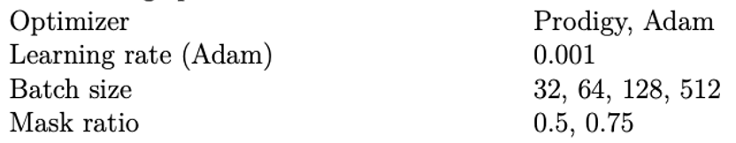
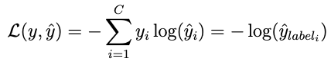
Method: Classifier fine-tuning
Cut away MAE decoder + add clf. head
Fine tune for 5 epochs
Hyperparameters:
Cross-entropy loss:
Dataset
Notes:
epoch
(hyperparams)

Slide 24
Results

Slide 25
Results
Accuracy is lifted (≈17%)
Model size could be smaller
Loss could filter bad images
We reconstruct better than ‘average blur’
We don’t see clustering in latent space

Slide 26
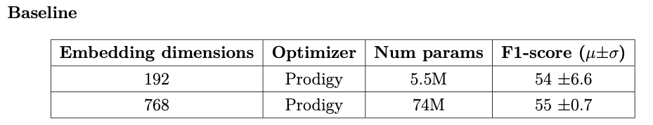

Slide 27
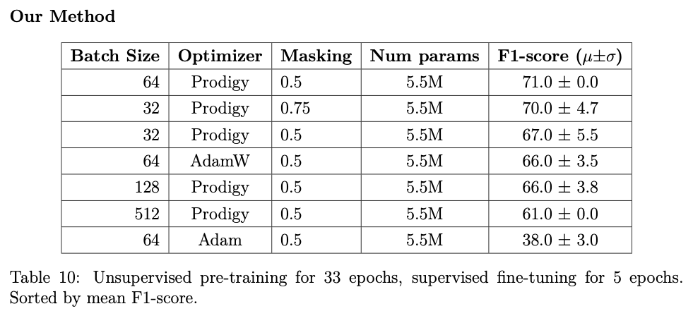

Slide 28
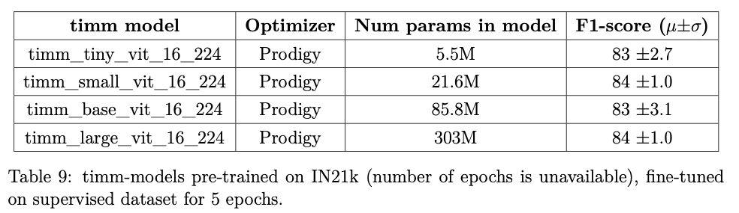

Slide 30
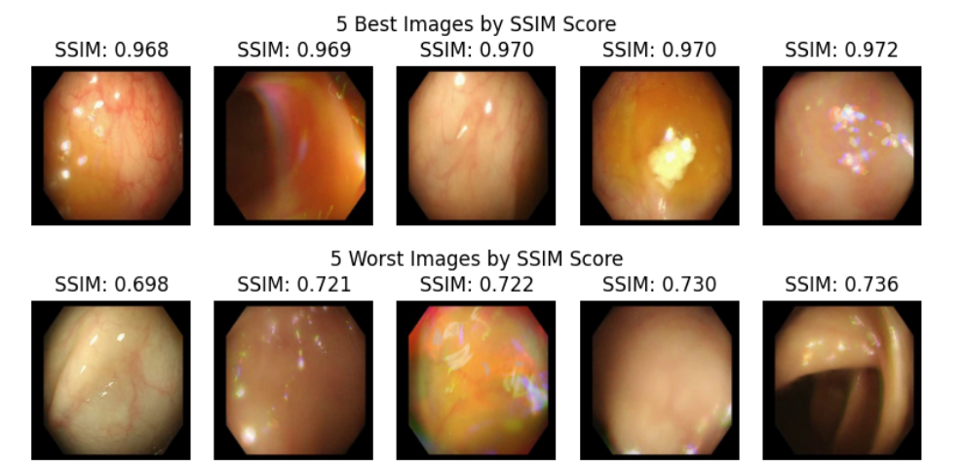
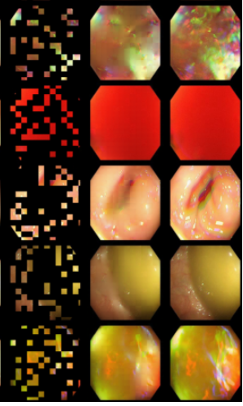
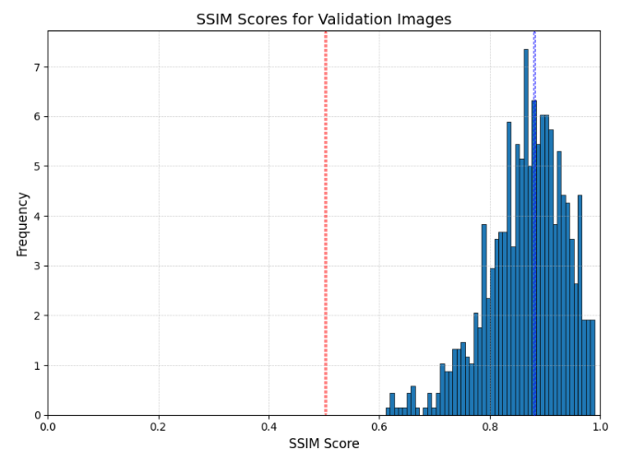
Distance
= 0,36

Slide 31
Distance
= 0,36
SSIM
mimics
human
perception

Slide 32
Will severity of illness cluster?

Slide 34
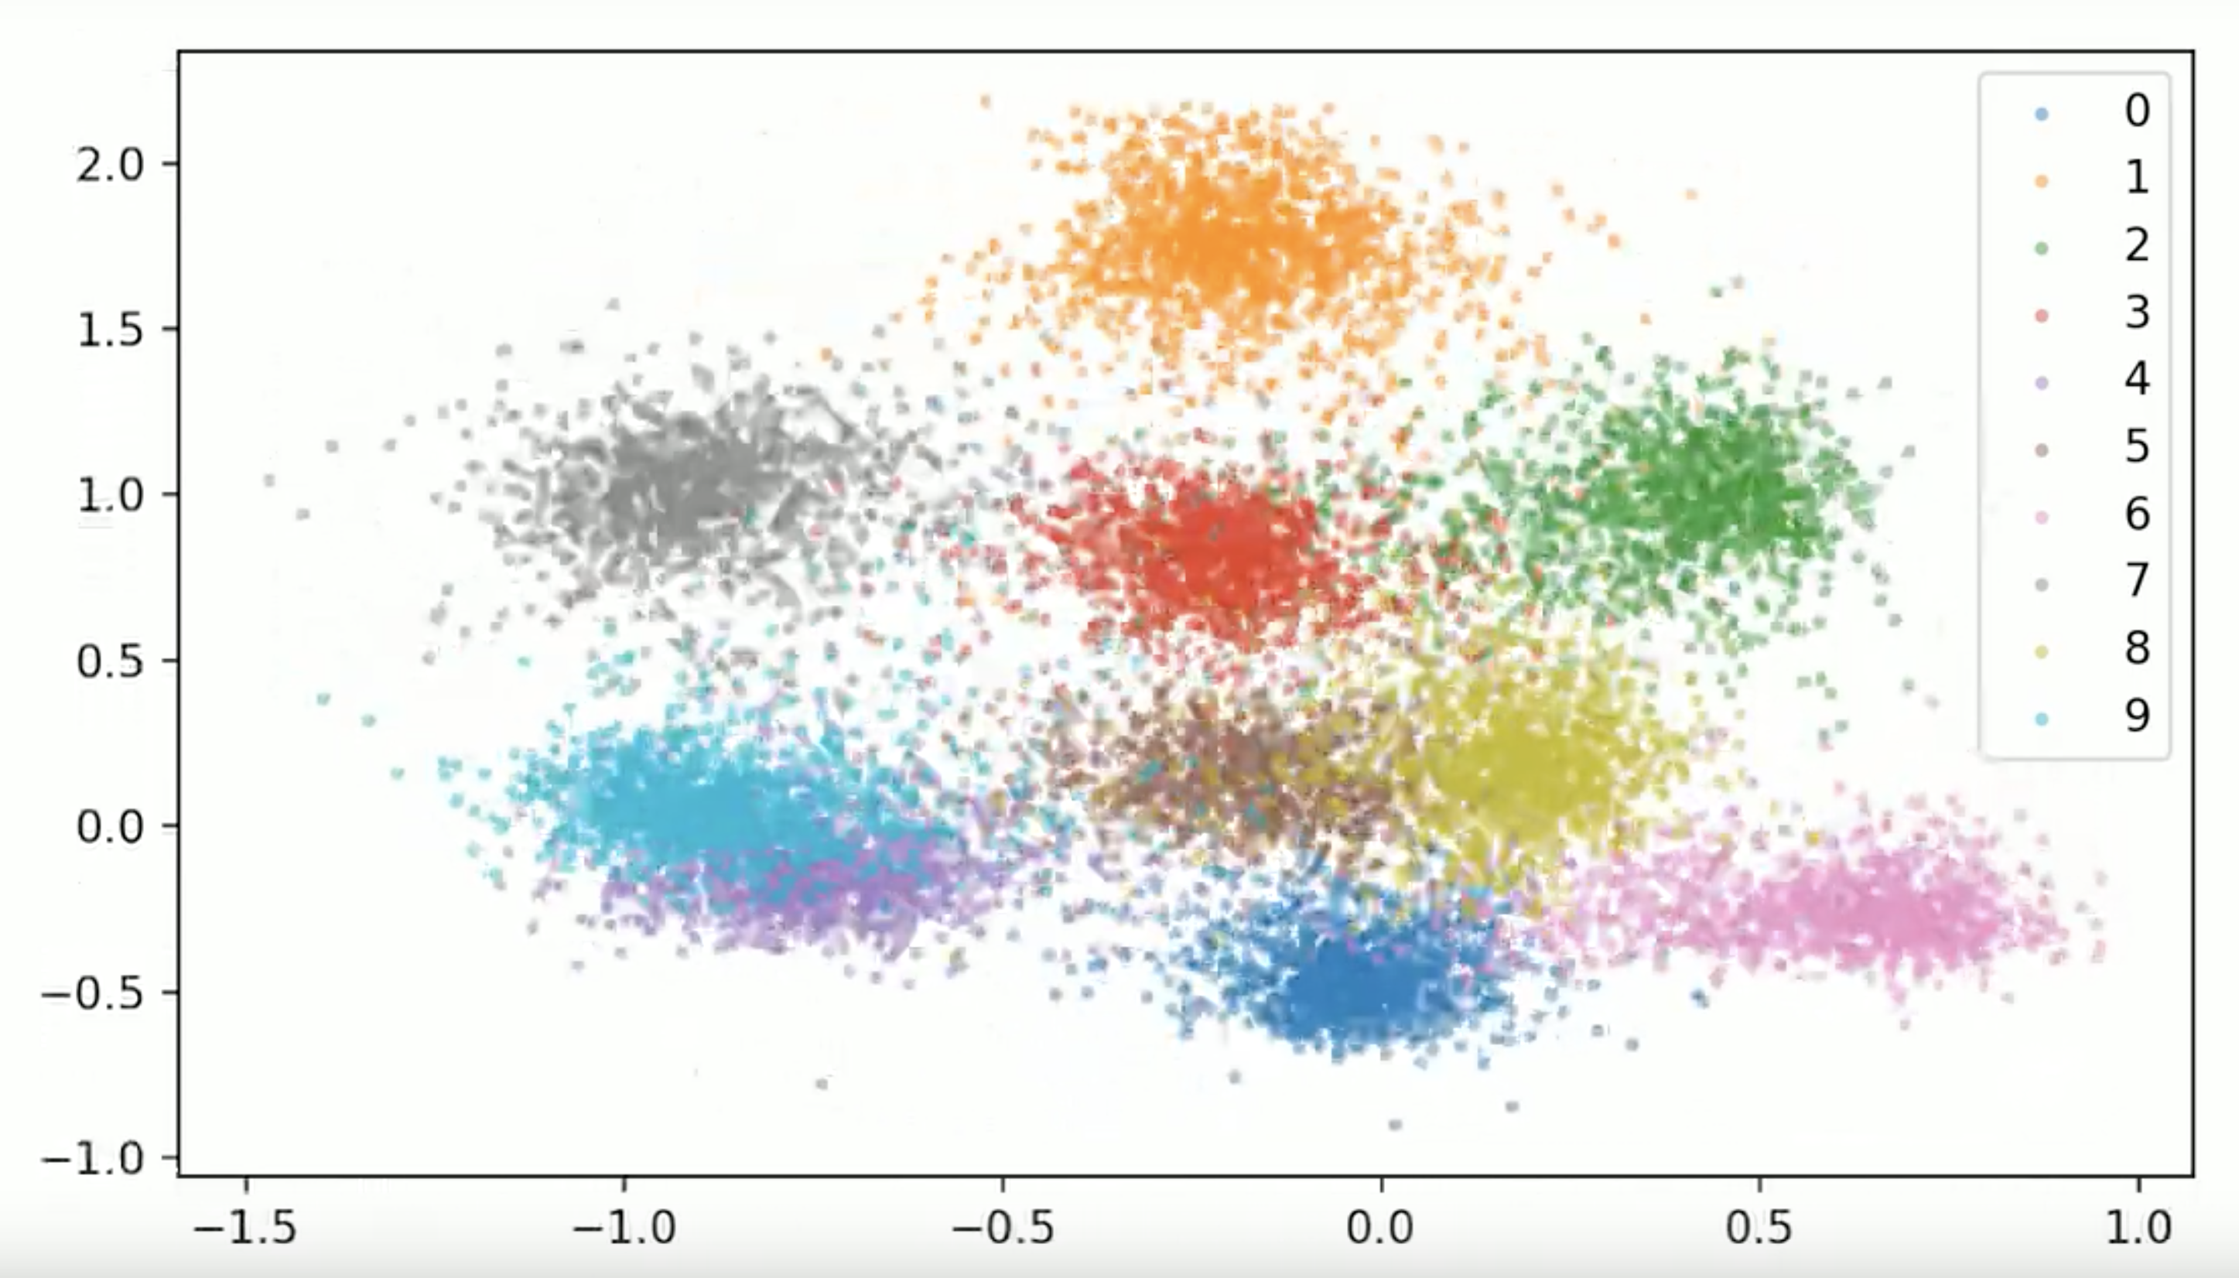
Dream scenario:

Slide 35
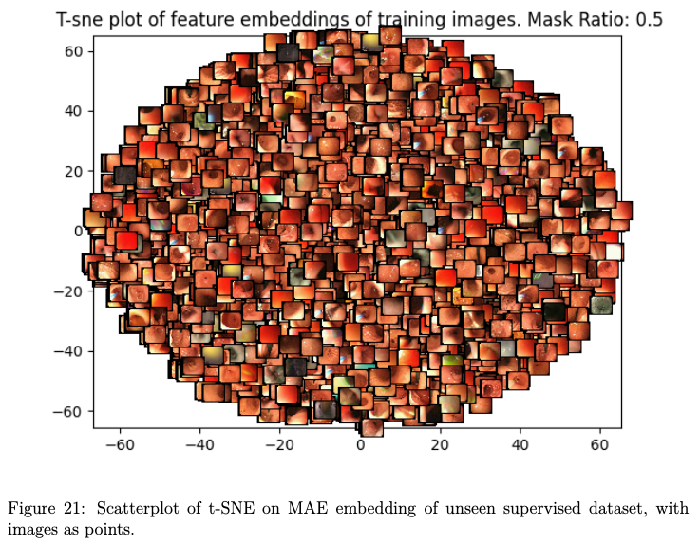
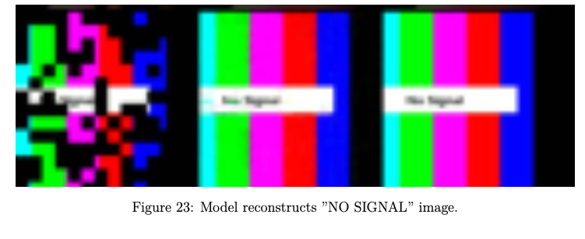

Slide 36
Our own critique

Slide 37
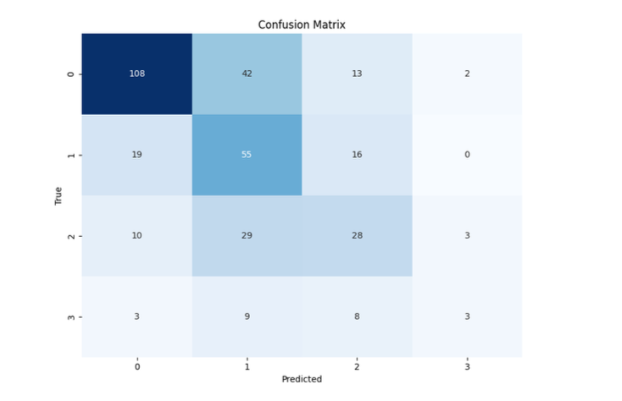
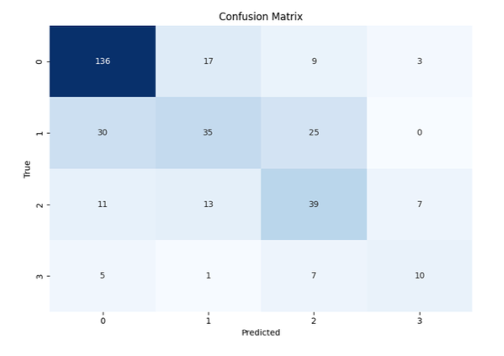
Baseline
Our method
More cautious around severe levels

Slide 38
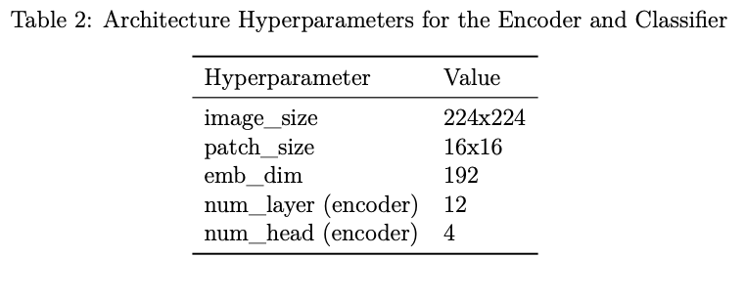

Slide 39
Should have used > 2 significant digits Should not have 100x’ed the F1-scores

Slide 40
Foundational Model for Endoscopy
Alexander Mittet

Slide 41
Appendix

Slide 42
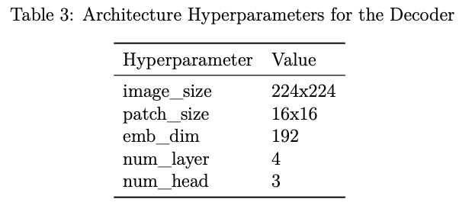
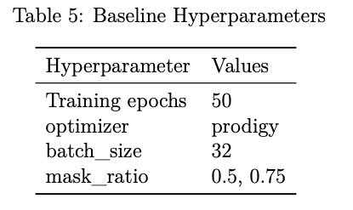
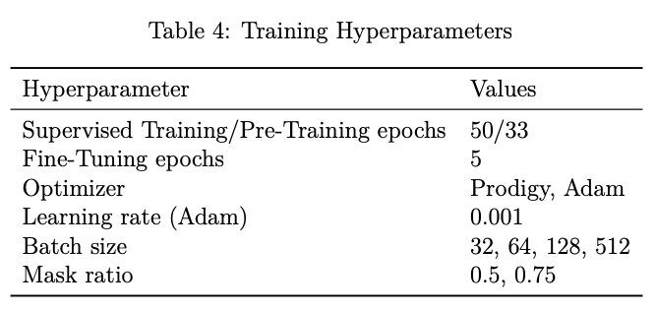

Slide 43
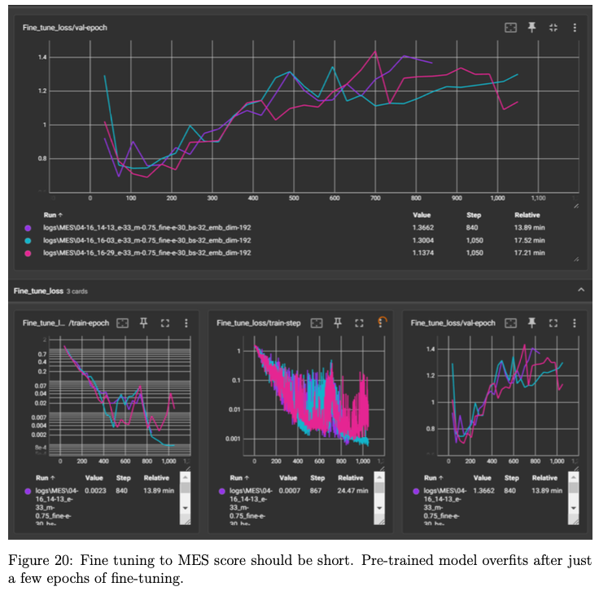

Slide 45
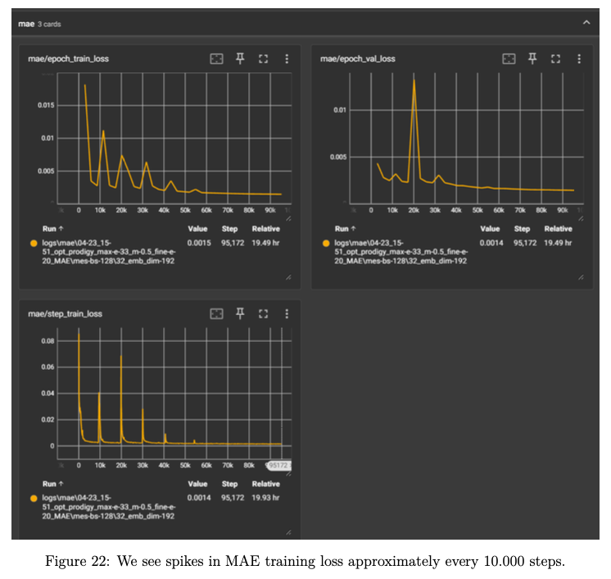

Slide 46
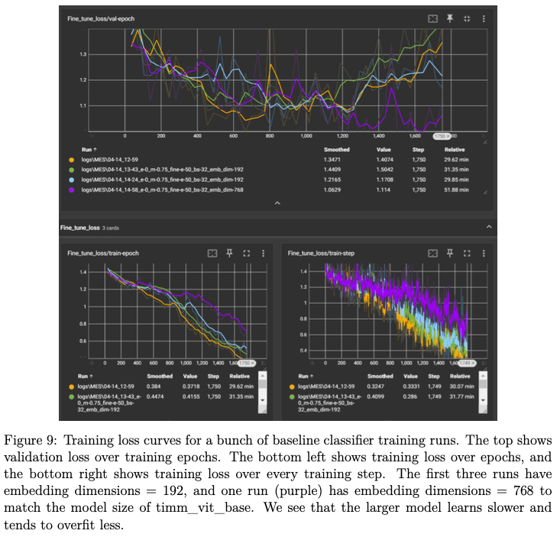

Slide 47
